Slide 1
Tutorial 8
Neural Networks
Dan Qiao
danqiao@link.cuhk.edu.cn
OH: 16:00~17:00, Friday, Seat 81, SDS Lab in ZX Building
Nov. 8, 2022

Slide 2
Outlines
Recap (10 min)
Multi Layer Perceptron
Computation Graph
Backpropagation & Chain rules
Demo (40 min)
Data Preprocessing
Example 1: Iris Classification
Example 2: LDAPS Regression
Extension: MNIST Classification by Pytorch

Slide 3
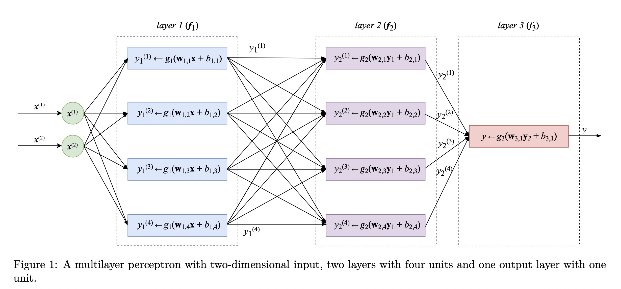
MLP

Slide 4
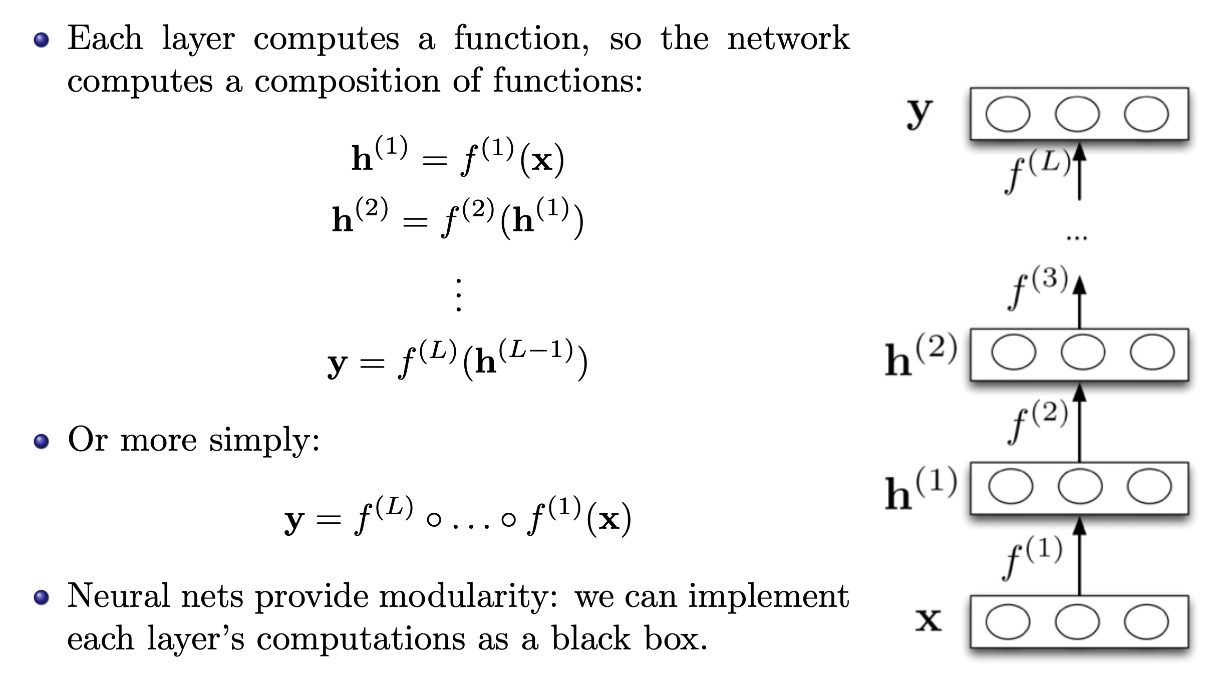
MLP

Slide 5
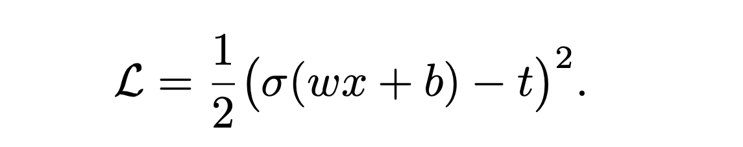
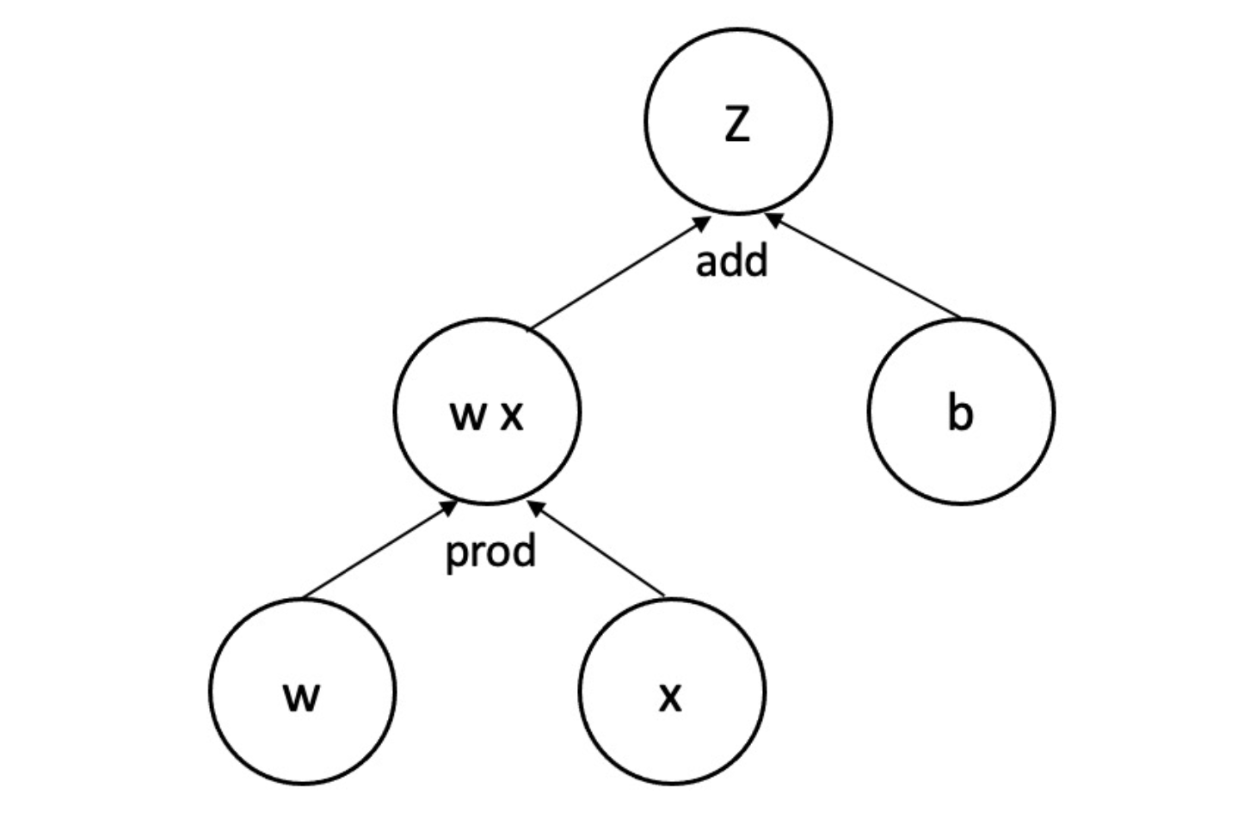

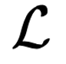
Computation Graph
Consider a loss function
y
t
Notes:
括号 bracket

Slide 6
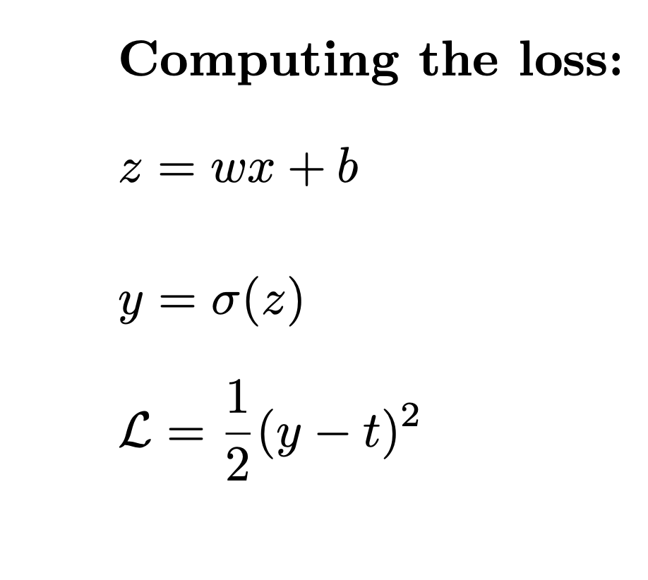
Computation Graph
Consider a loss function
y
t

Slide 7
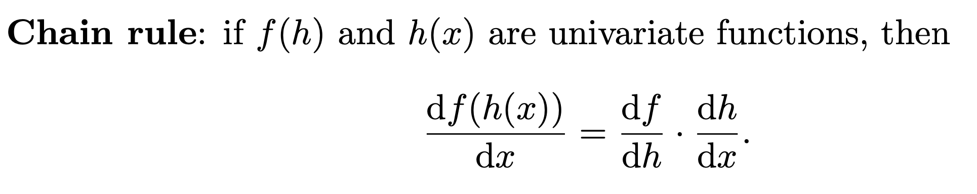
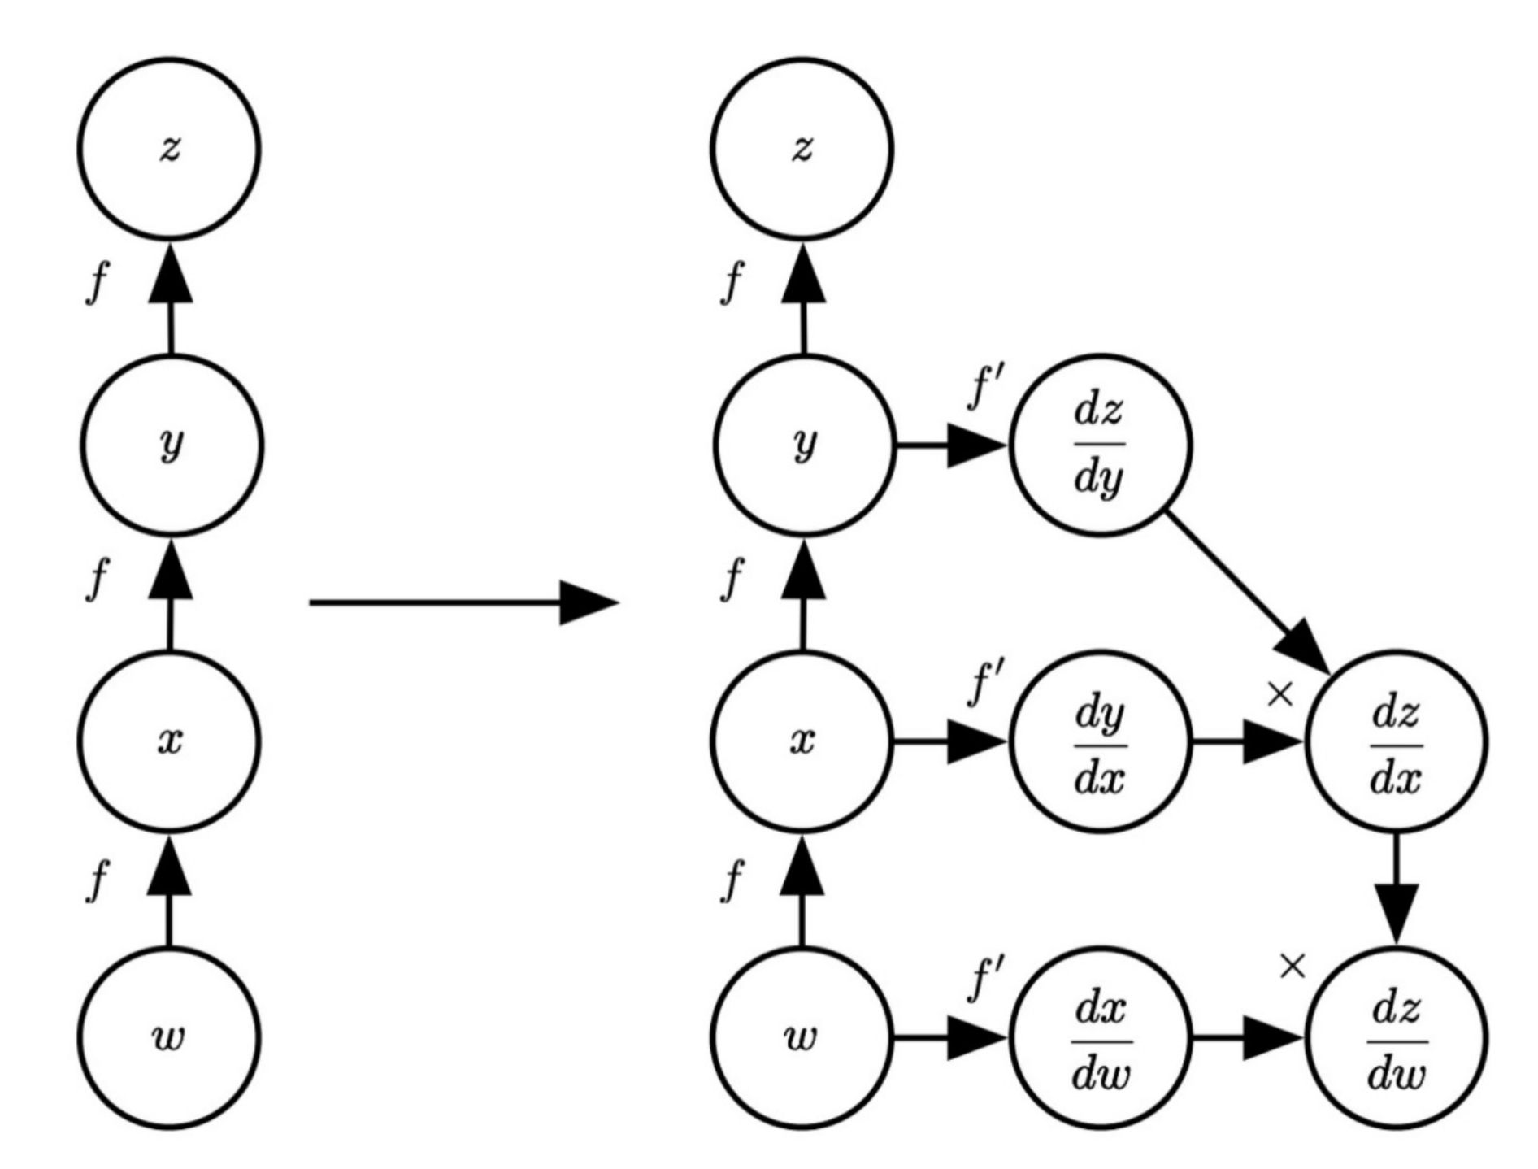
Chain Rule
Notes:
partial derivative f sub x.
Derivative of f with respect to x.

Slide 8
Back Propagation

Slide 9
Back Propagation

Slide 10

Back Propagation
Loss
Neural Network
y
…
z₁
z₂
z_{D}
…
x₁
x₂
x₃
x_{M}

Slide 11
Outlines
Recap (10 min)
Multi Layer Perceptron
Computation Graph
Backpropagation & Chain rules
Demo (40 min)
Data Preprocessing
Example 1: Iris Classification
Example 2: LDAPS Regression
Extension: MNIST Classification by Pytorch

Slide 12
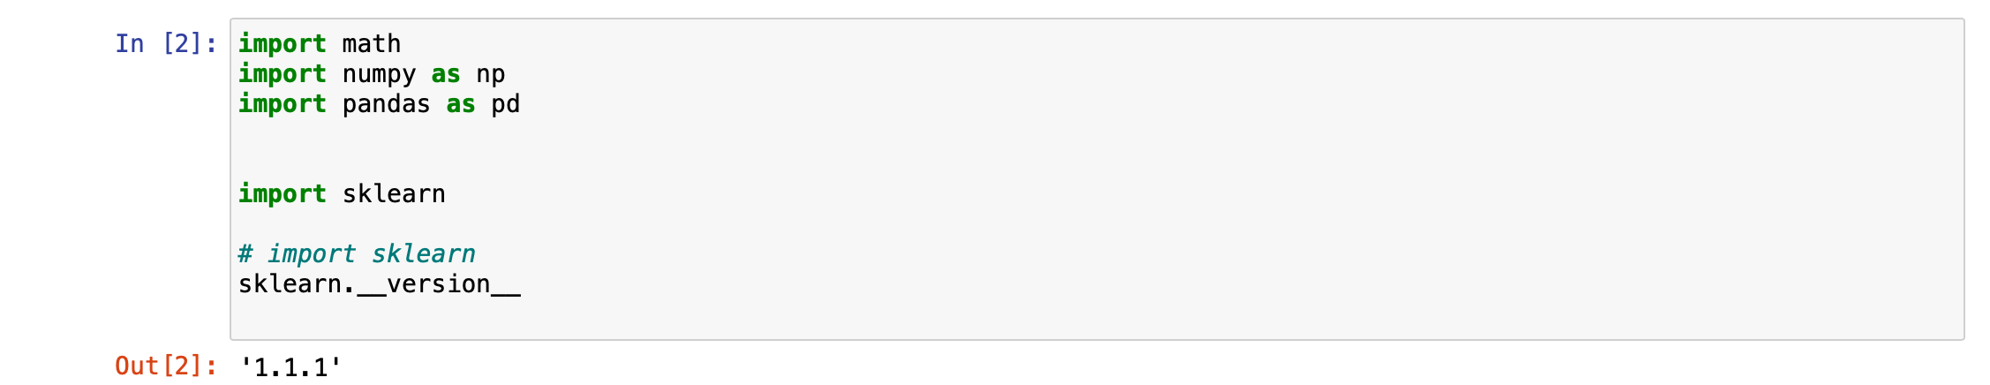
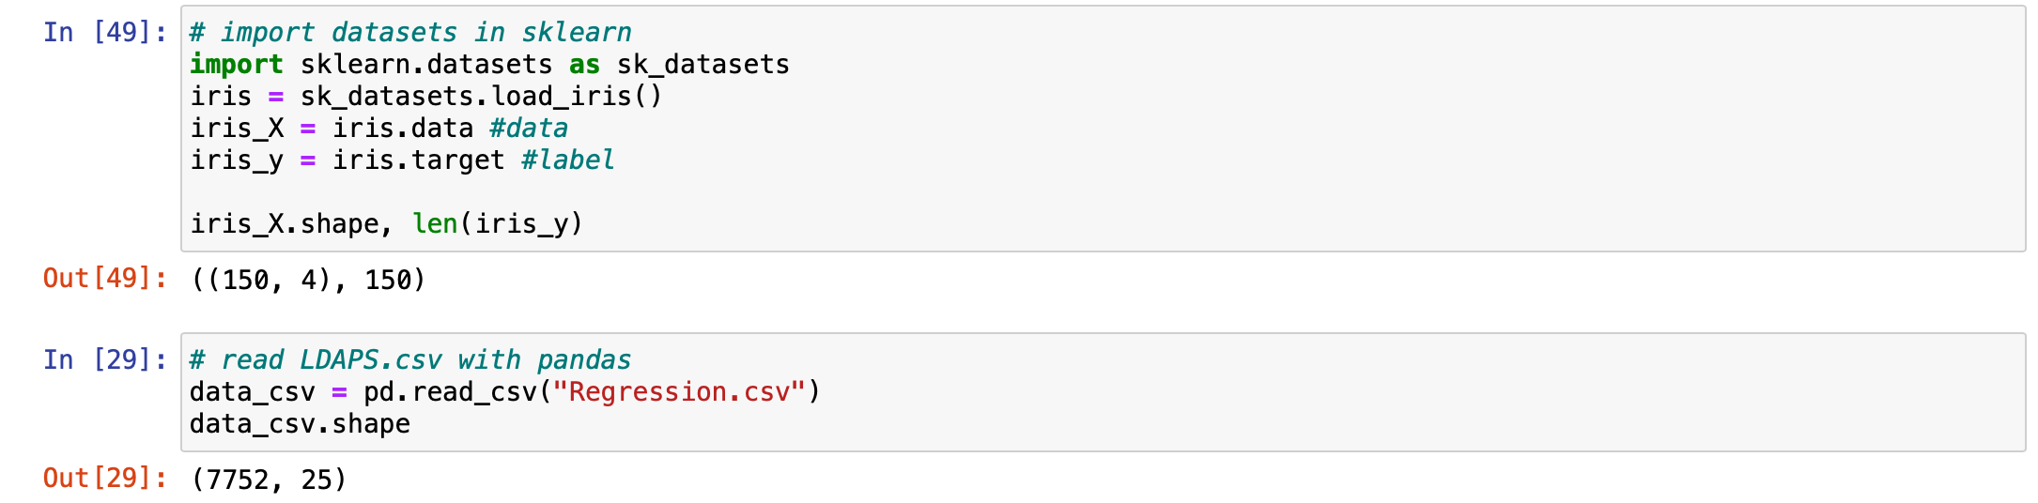
Data Preprocessing
Preprocessing Steps:
Load Datasets
Observe Data
Data Clean
Split Train-Test Set
Choose Your ML Model

Slide 13
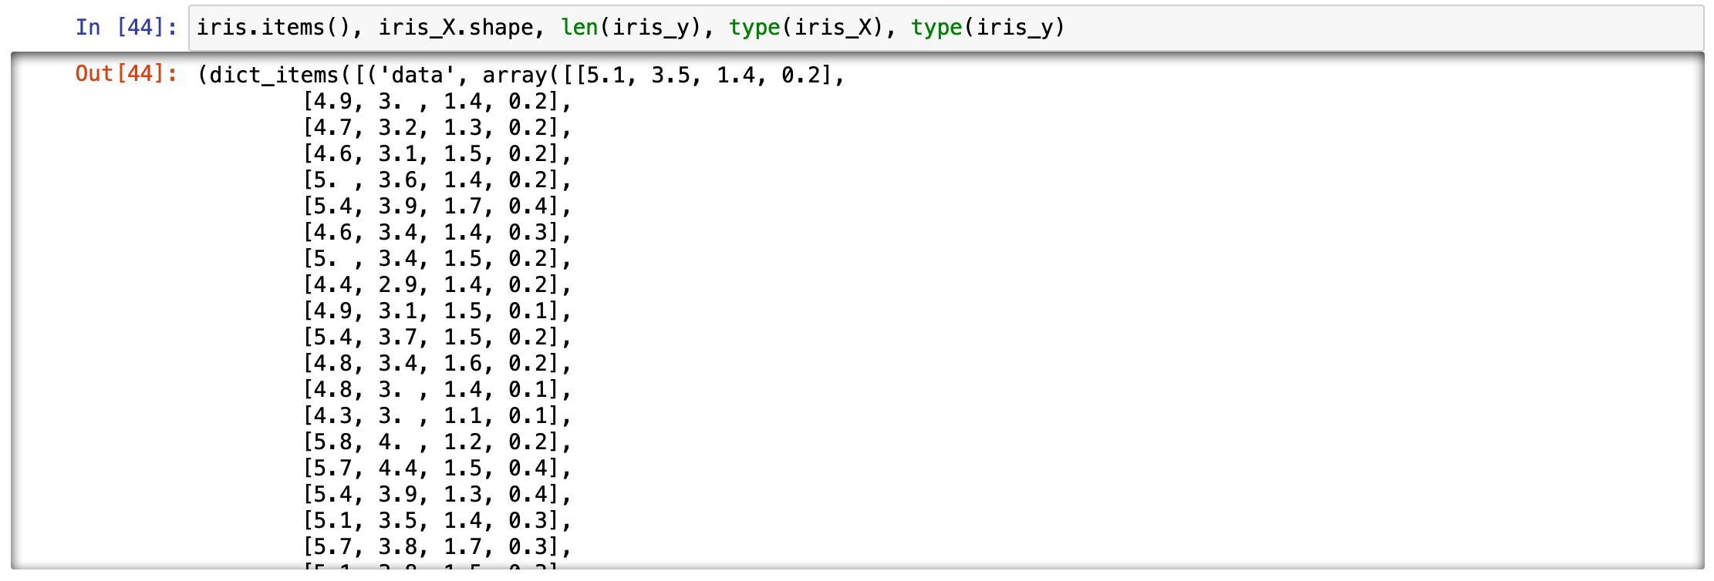
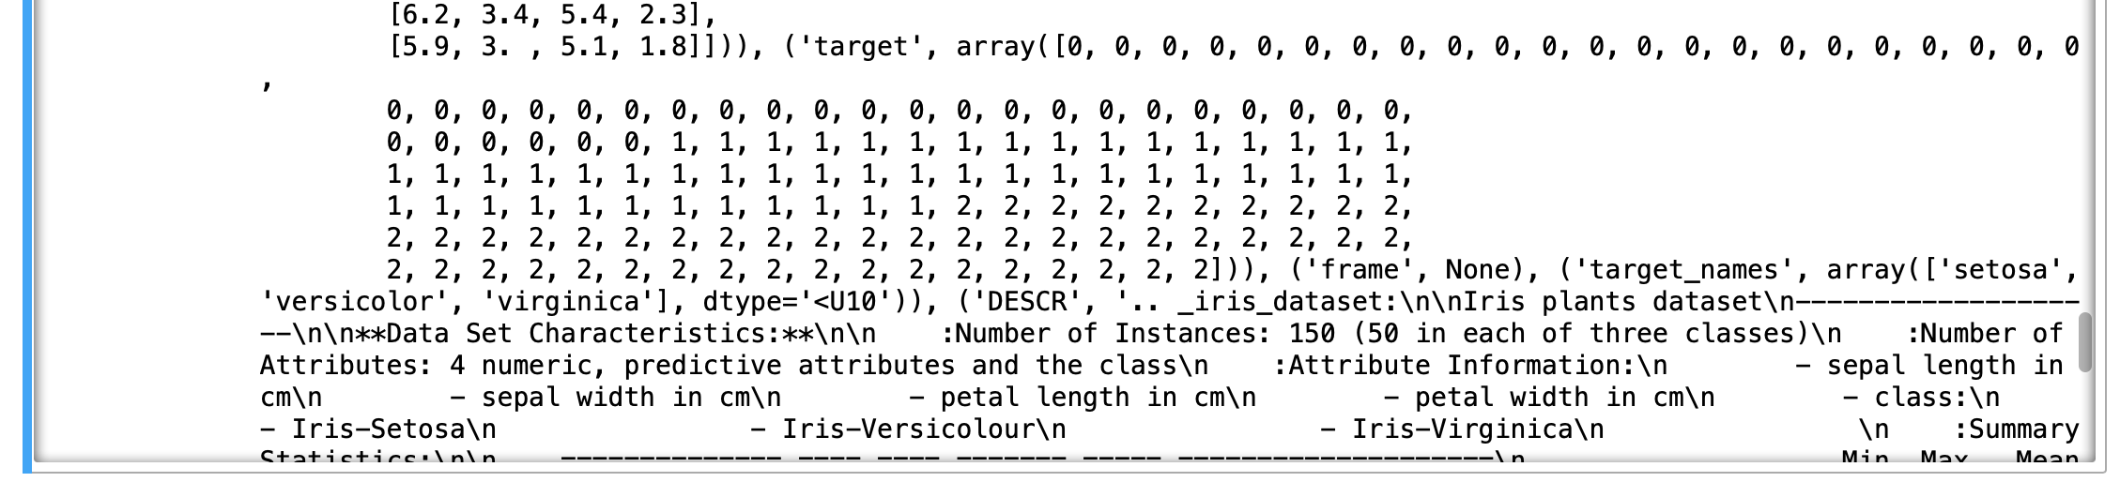
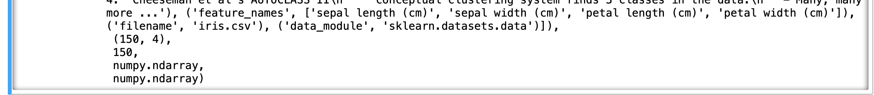
Data Preprocessing
Preprocessing Steps:
Load Datasets
Observe Data
Data Clean
Split Train-Test Set
Choose Your ML Model

Slide 14
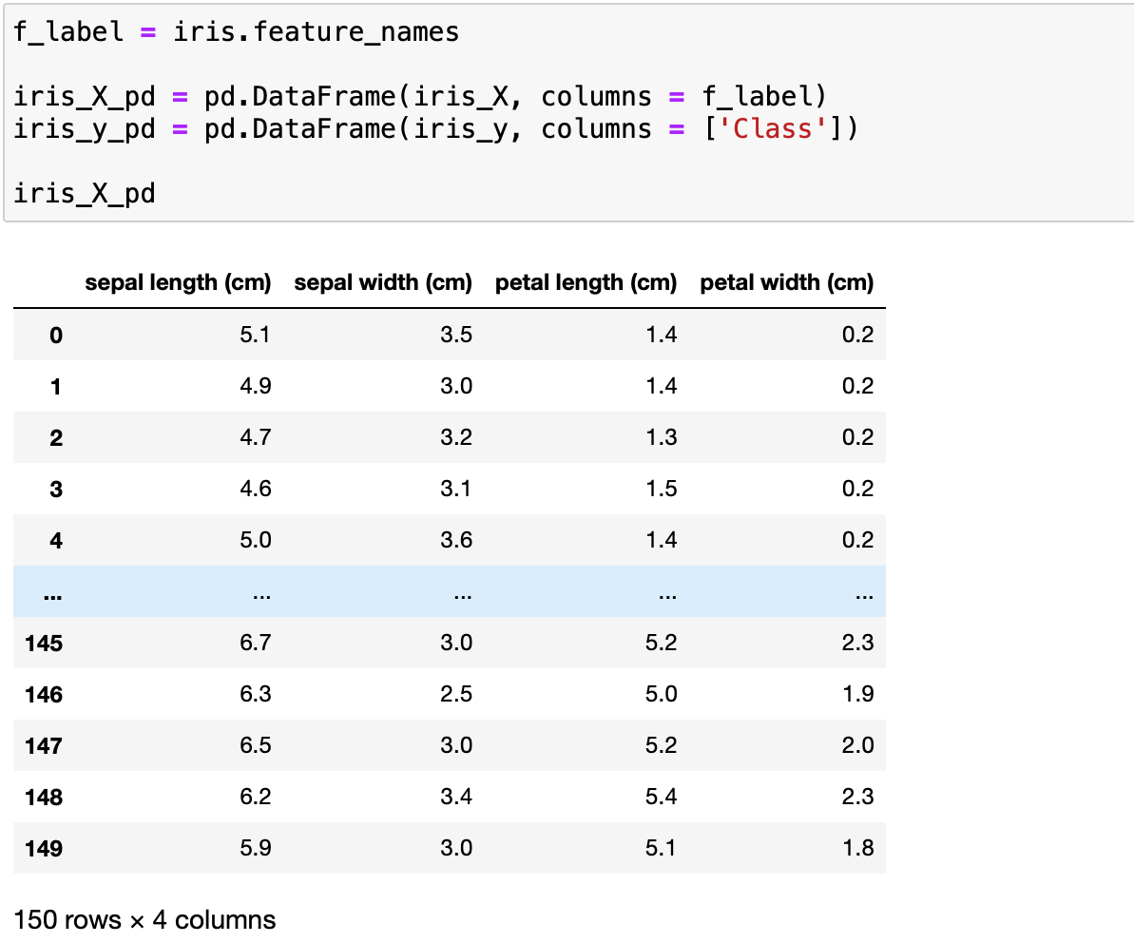
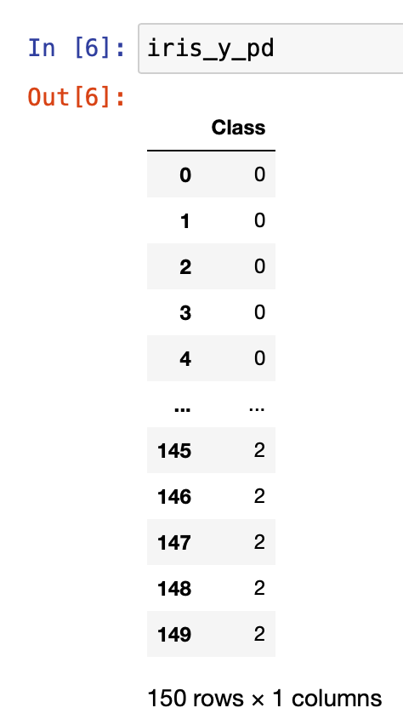
Data Preprocessing
Preprocessing Steps:
Load Datasets
Observe Data
Data Clean
Split Train-Test Set
Choose Your ML Model
The Iris Dataset

Slide 15
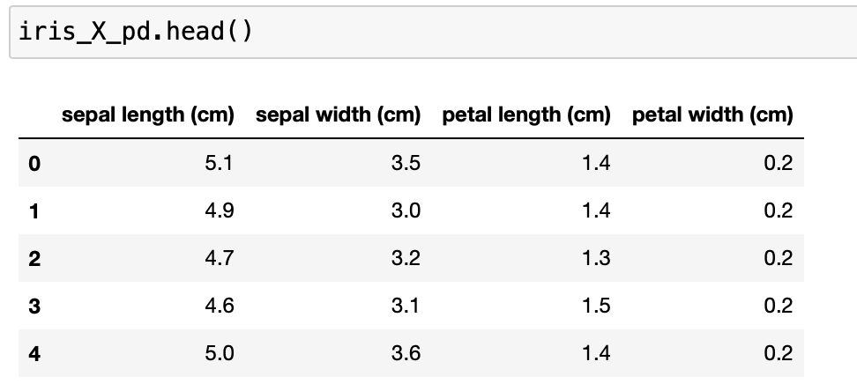
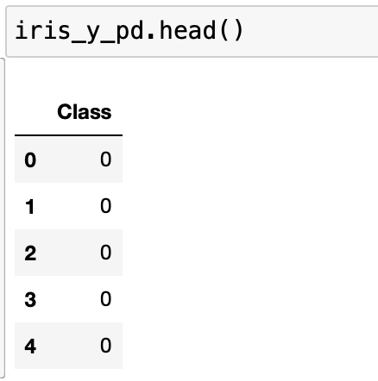
Data Preprocessing
Preprocessing Steps:
Load Datasets
Observe Data
Data Clean
Split Train-Test Set
Choose Your ML Model
The Iris Dataset

Slide 16
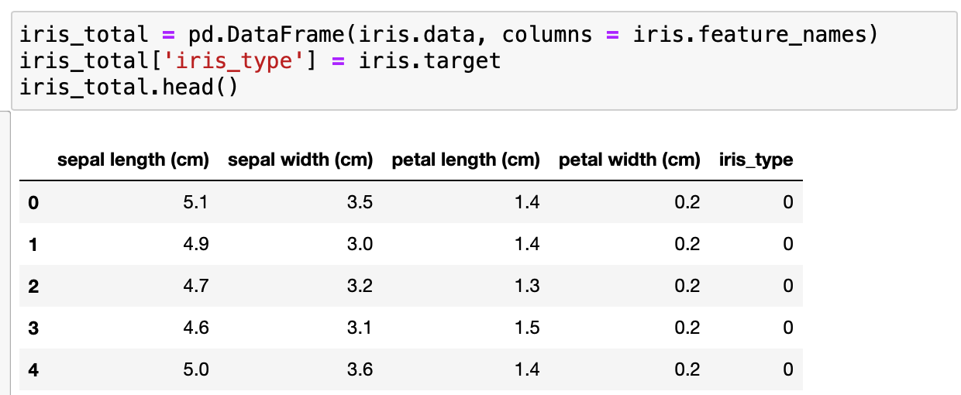
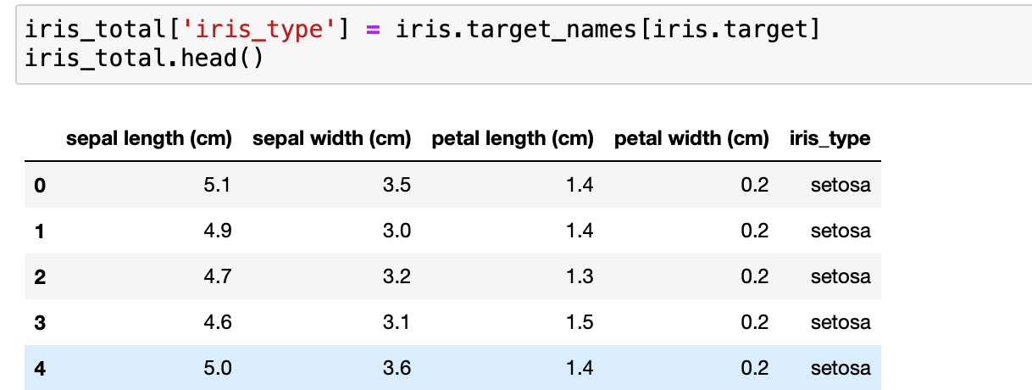
Data Preprocessing
Preprocessing Steps:
Load Datasets
Observe Data
Data Clean
Split Train-Test Set
Choose Your ML Model
The Iris Dataset

Slide 17
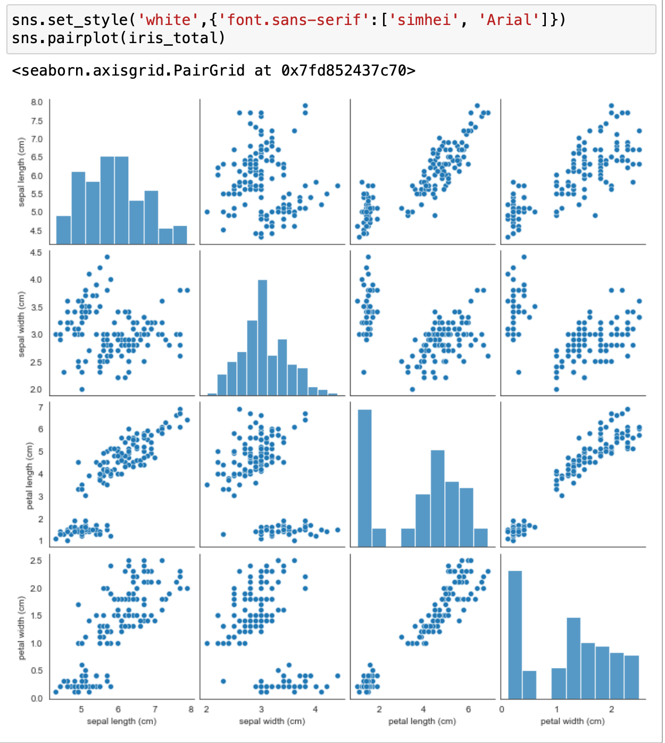
Data Preprocessing
Preprocessing Steps:
Load Datasets
Observe Data
Data Clean
Split Train-Test Set
Choose Your ML Model

Slide 18
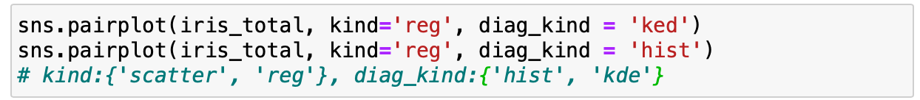
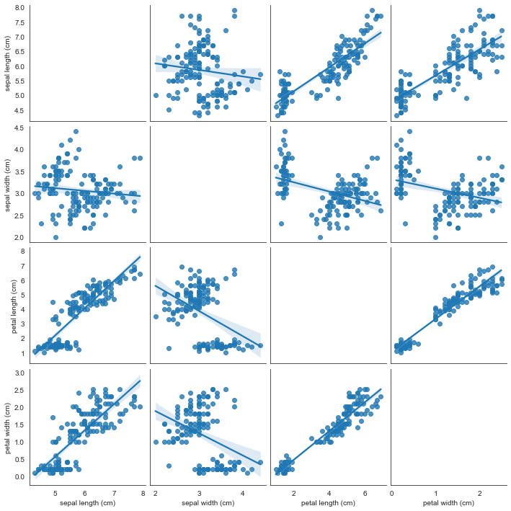
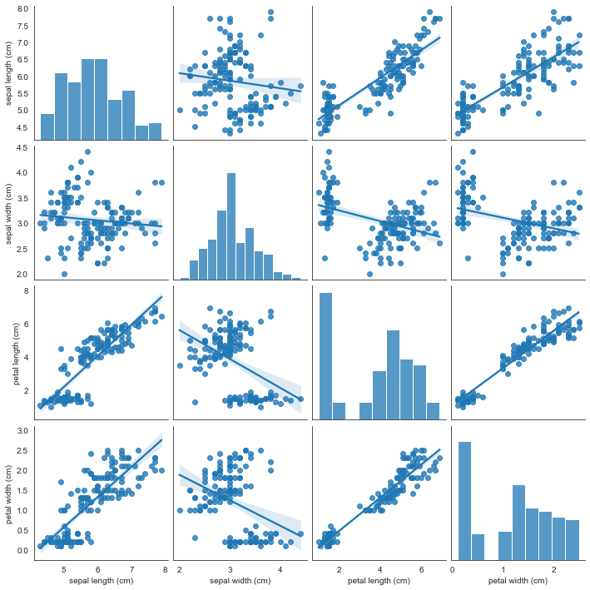
Data Preprocessing
Preprocessing Steps:
Load Datasets
Observe Data
Data Clean
Split Train-Test Set
Choose Your ML Model

Slide 19
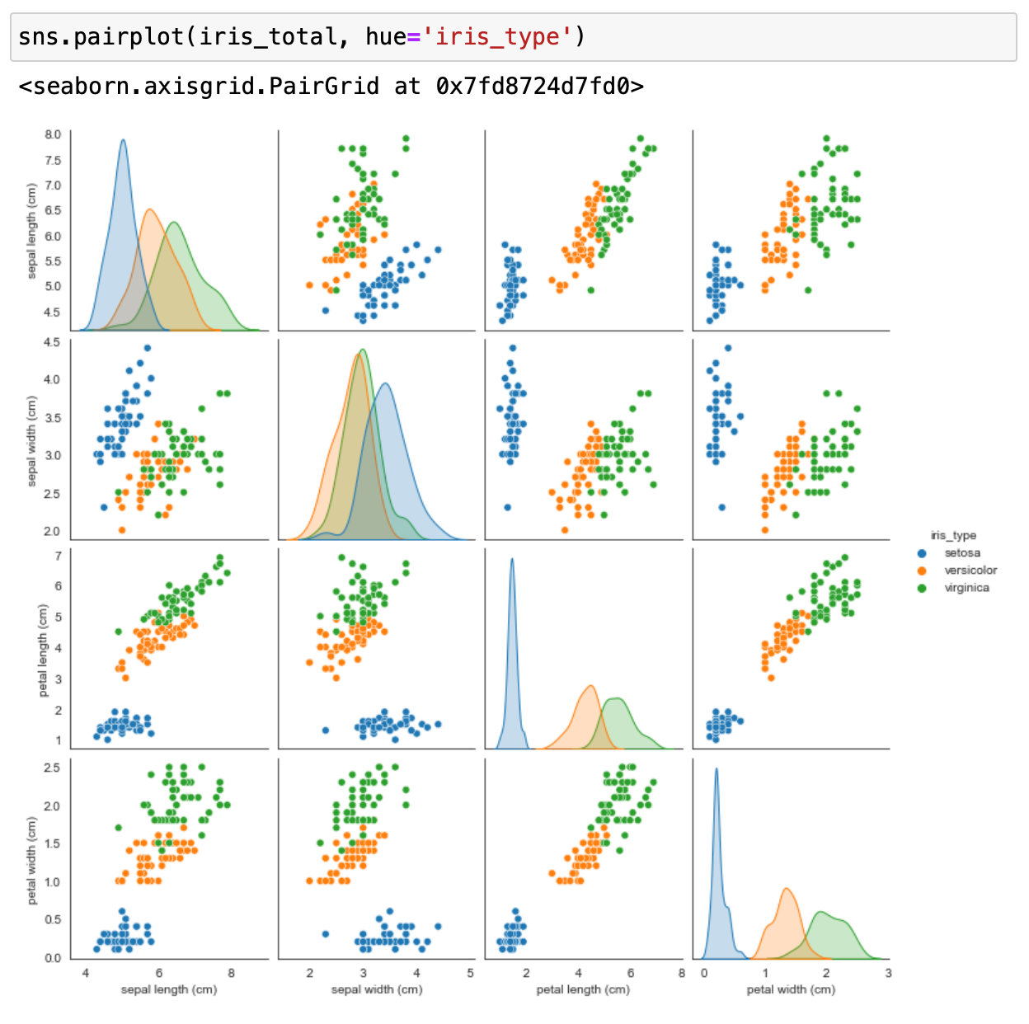
Data Preprocessing
Preprocessing Steps:
Load Datasets
Observe Data
Data Clean
Split Train-Test Set
Choose Your ML Model

Slide 20
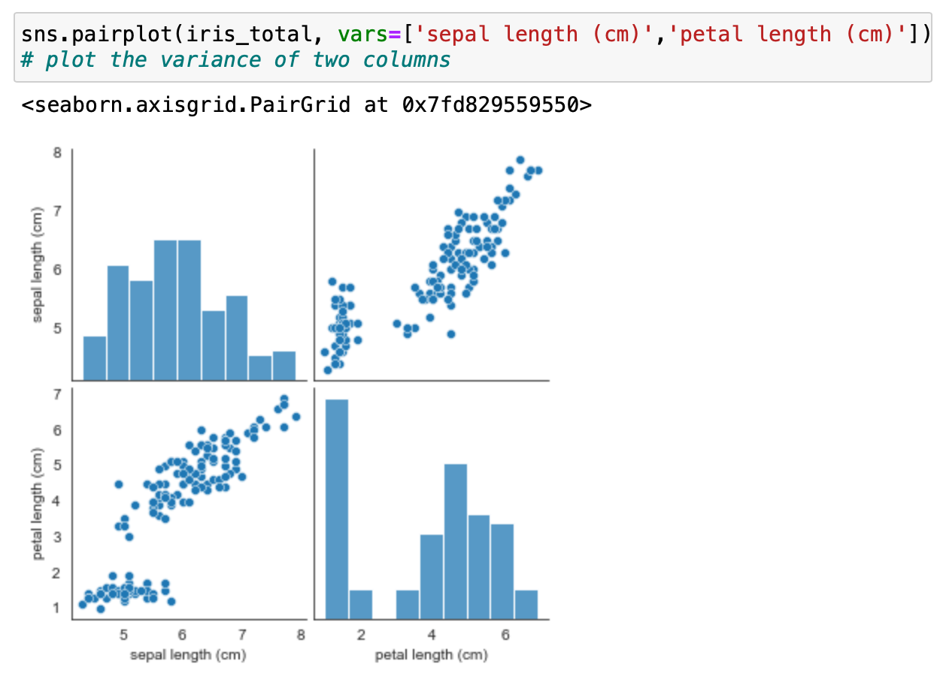
Data Preprocessing
Preprocessing Steps:
Load Datasets
Observe Data
Data Clean
Split Train-Test Set
Choose Your ML Model

Slide 21
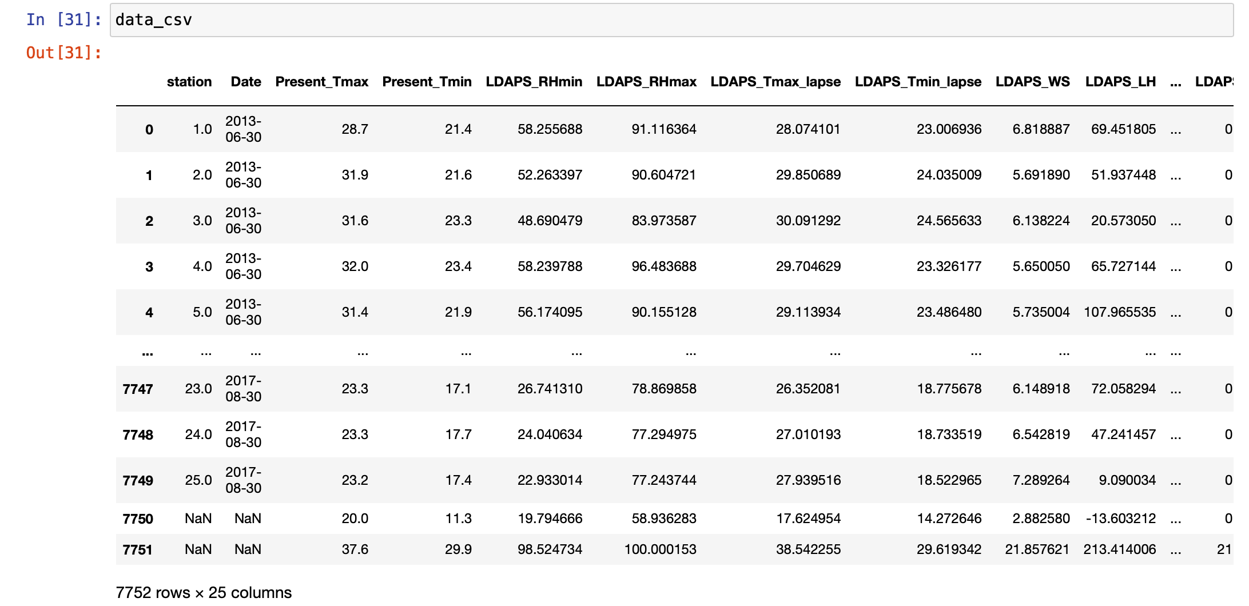
Data Preprocessing
Preprocessing Steps:
Load Datasets
Observe Data
Data Clean
Split Train-Test Set
Choose Your ML Model
The LADPS Dataset

Slide 22
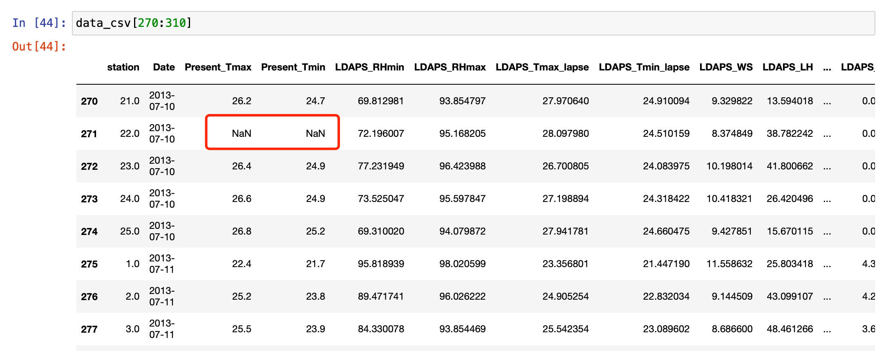
Data Preprocessing
Preprocessing Steps:
Load Datasets
Observe Data
Data Clean
Split Train-Test Set
Choose Your ML Model
There are some unusual data point

Slide 23
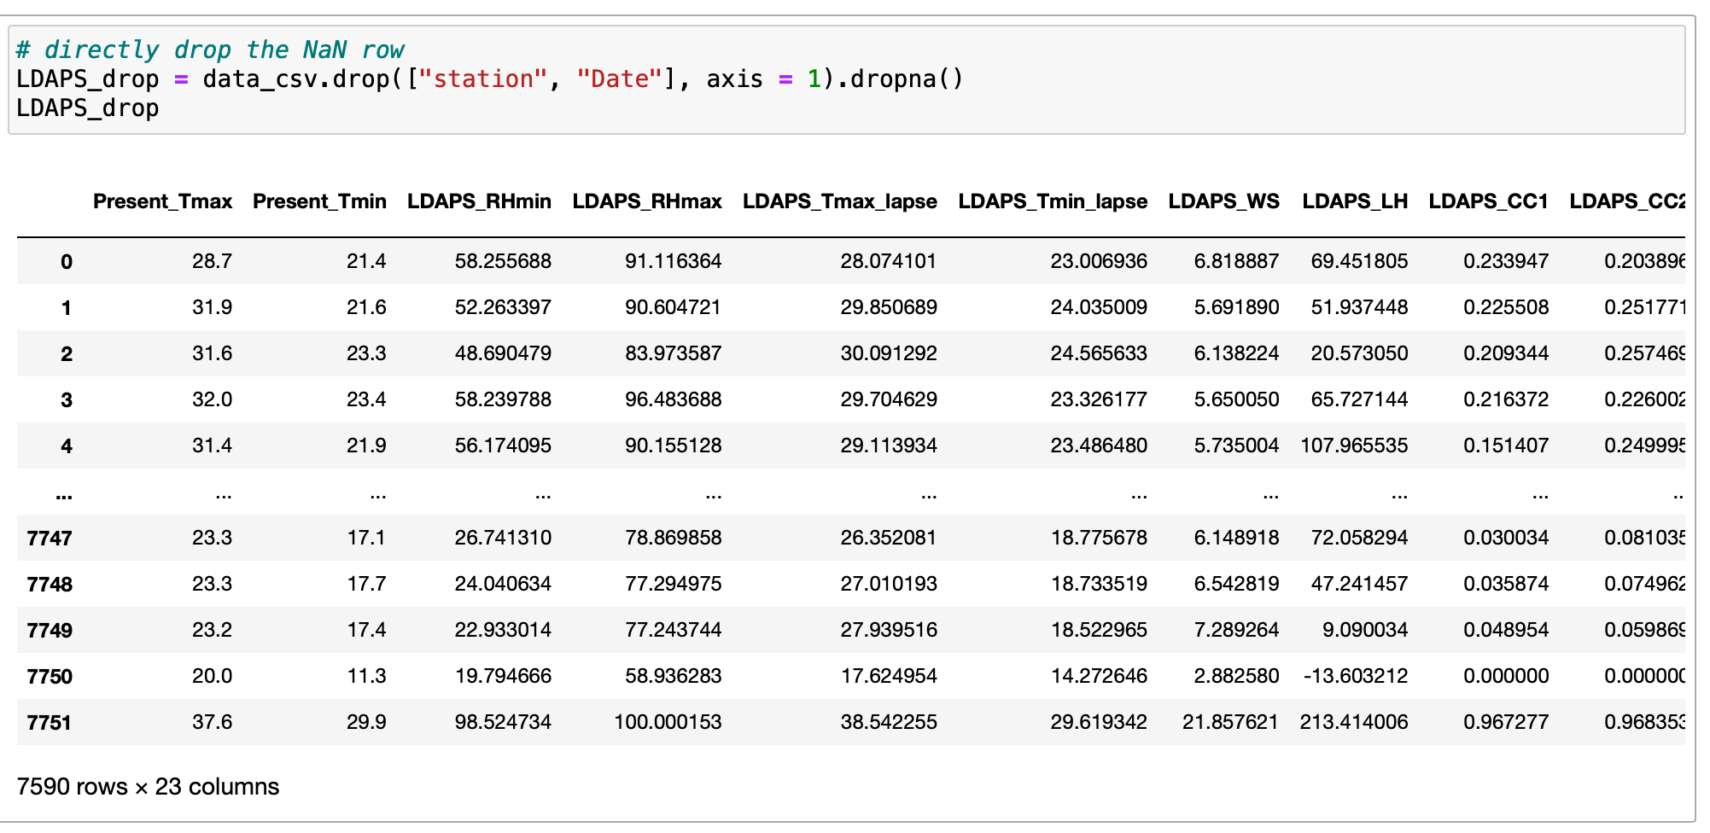
Data Preprocessing
Drop the full data row, or fill the NaN with the mean value
Preprocessing Steps:
Load Datasets
Observe Data
Data Clean
Split Train-Test Set
Choose Your ML Model

Slide 24
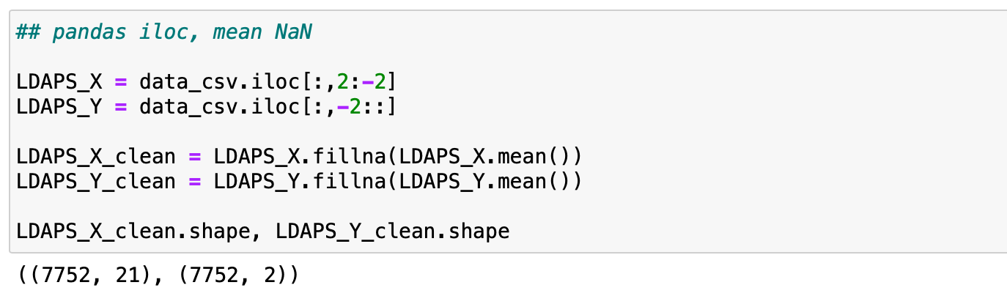
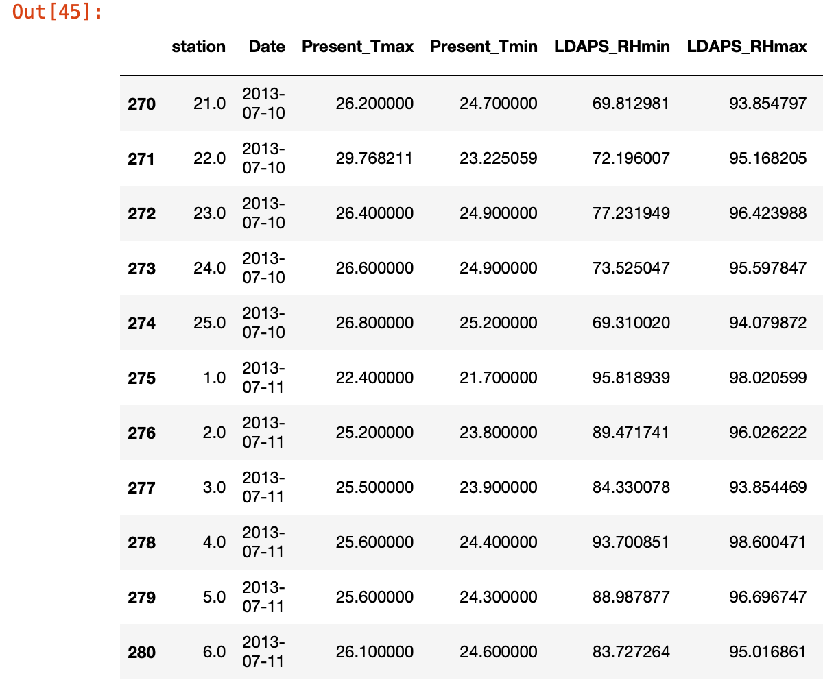
Data Preprocessing
Drop the full data row, or fill the NaN with the mean value
Preprocessing Steps:
Load Datasets
Observe Data
Data Clean
Split Train-Test Set
Choose Your ML Model

Slide 25
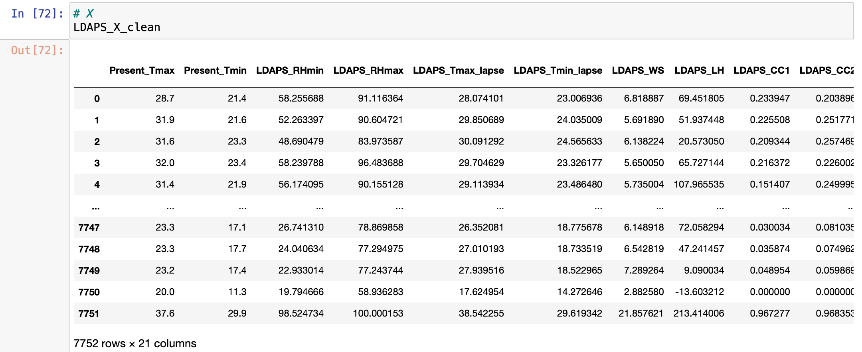
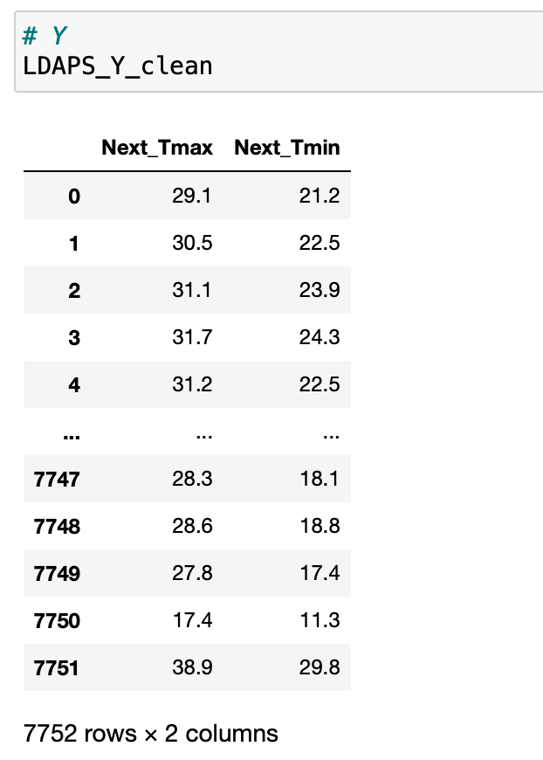
Data Preprocessing
Preprocessing Steps:
Load Datasets
Observe Data
Data Clean
Split Train-Test Set
Choose Your ML Model

Slide 26
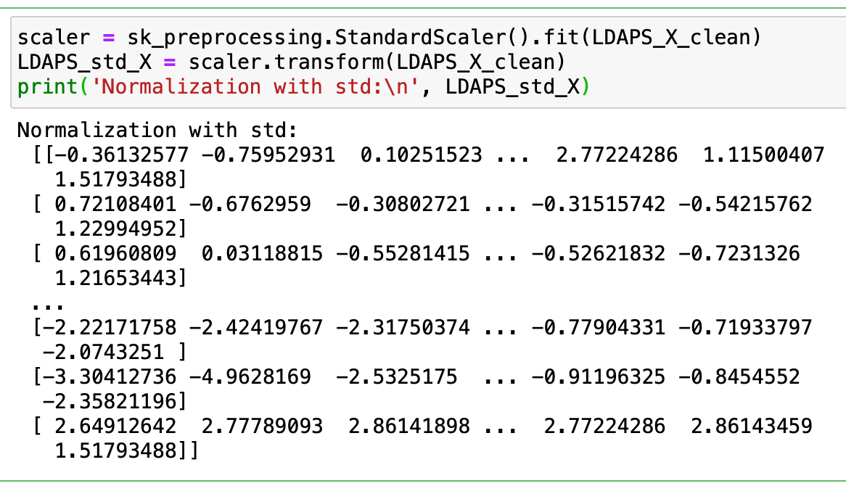
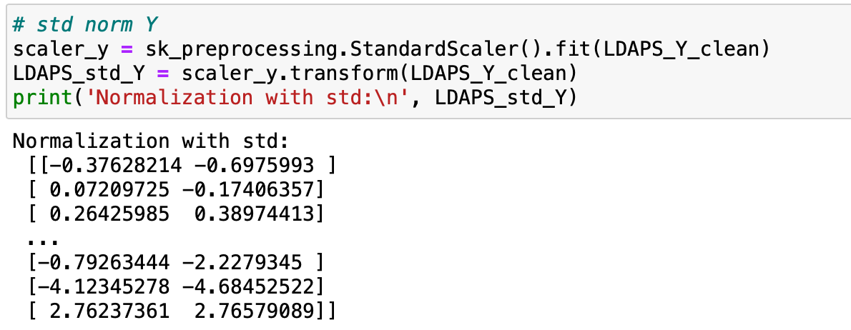
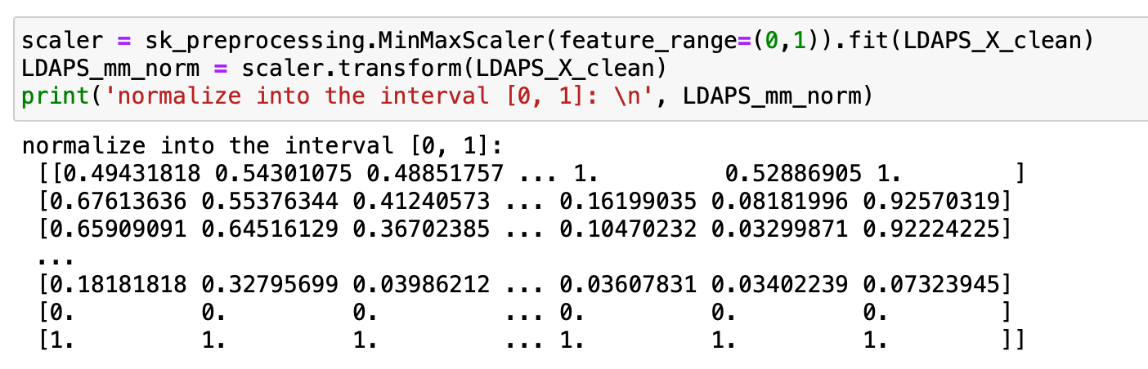
Data Preprocessing
Sometimes we need to normalize the datasets
Preprocessing Steps:
Load Datasets
Observe Data
Data Clean
Split Train-Test Set
Choose Your ML Model

Slide 27
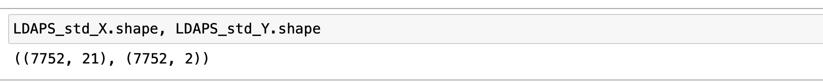
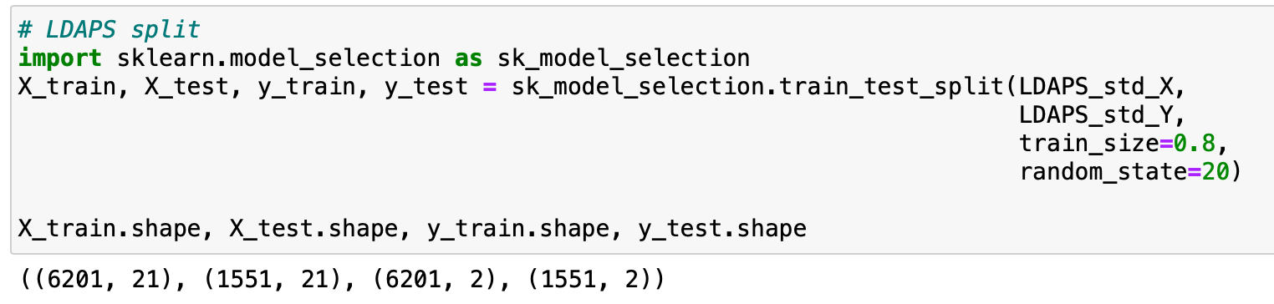
Data Preprocessing
Preprocessing Steps:
Load Datasets
Observe Data
Data Clean
Split Train-Test Set
Choose Your ML Model
Split into two 80%-20% Train-Test Sets

Slide 28
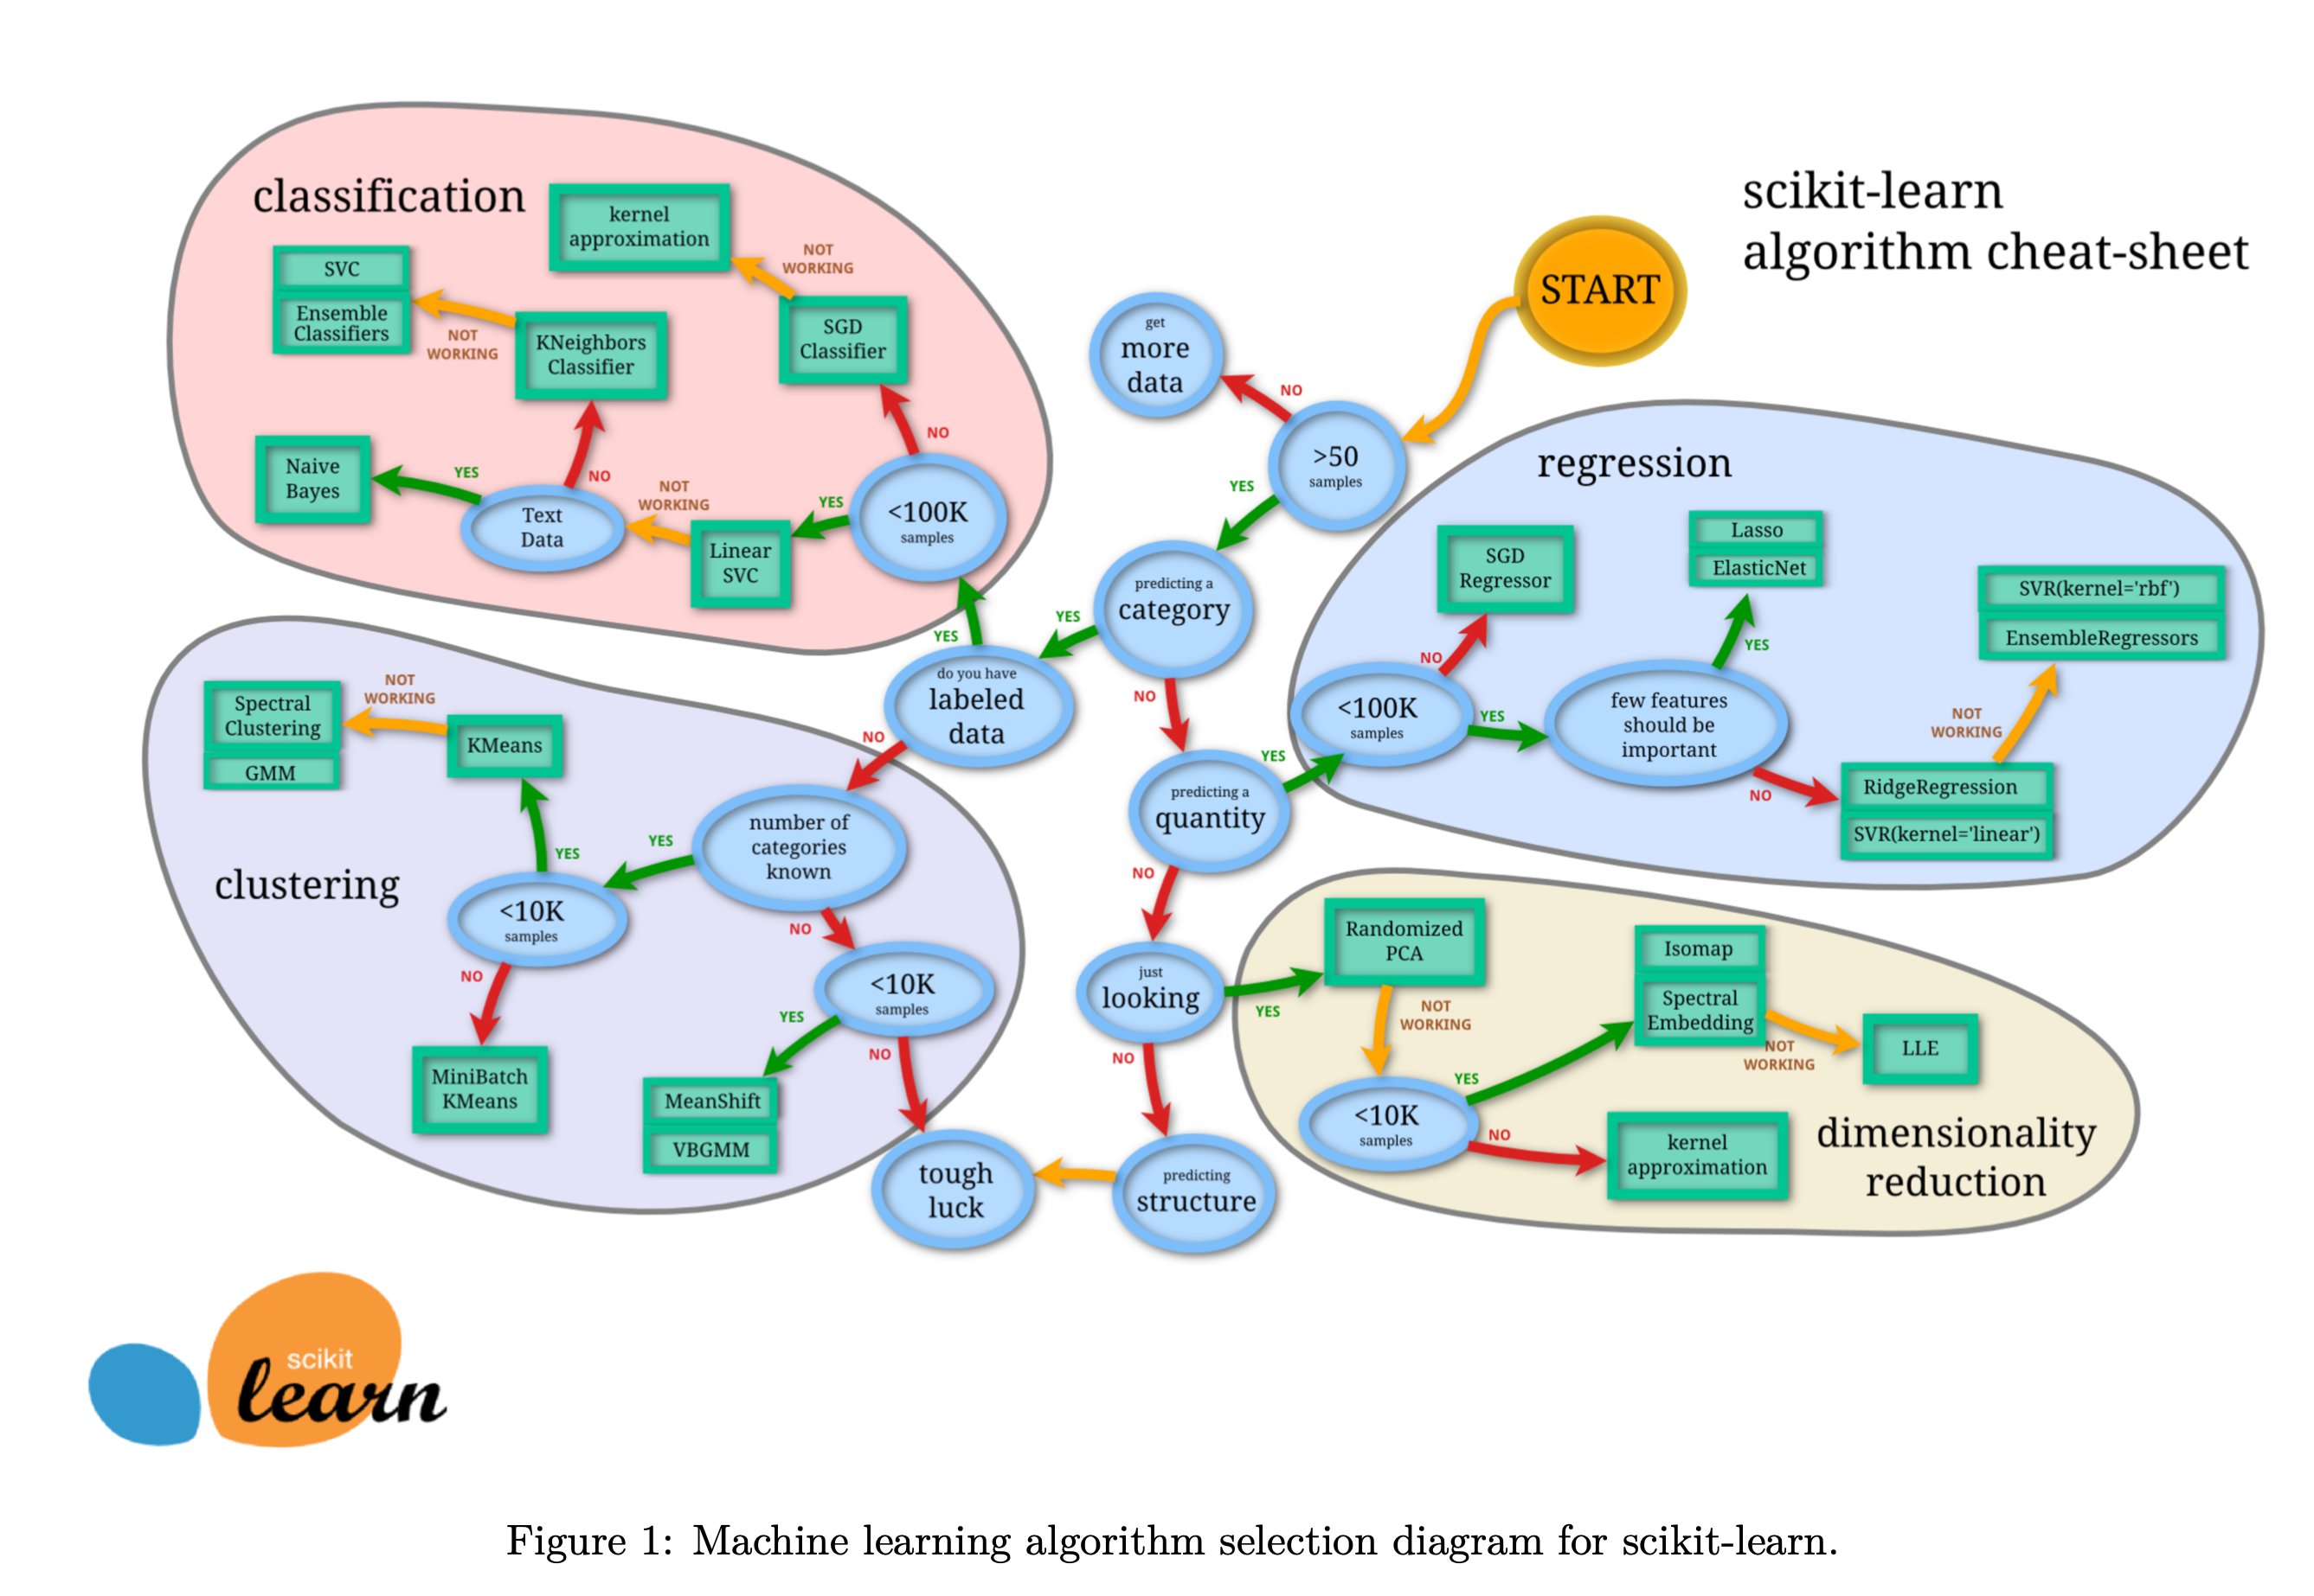
Data Preprocessing
Preprocessing Steps:
Load Datasets
Observe Data
Data Clean
Split Train-Test Set
Choose Your ML Model
The hundred-page machine learning book-Andriy Burkov (2019)

Slide 29
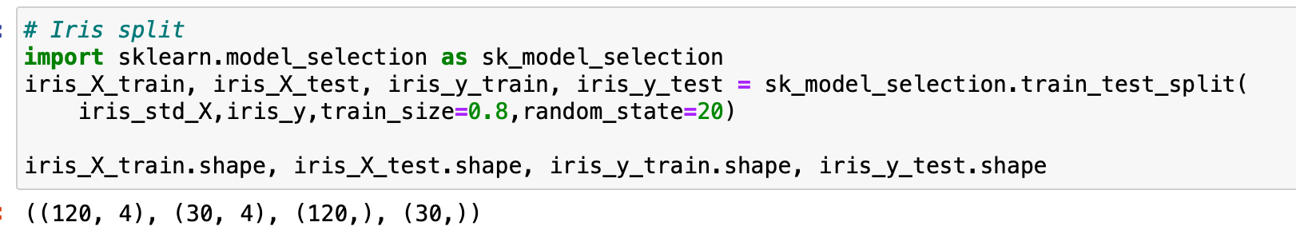
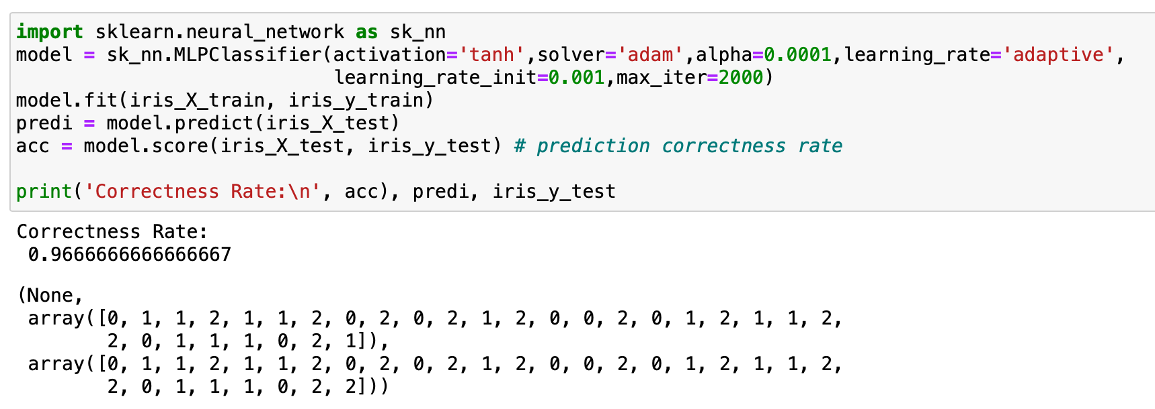
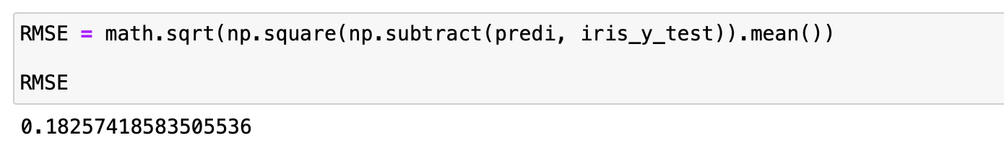
Example 1: Iris Classification
Adaptive Moment Estimation

Slide 30
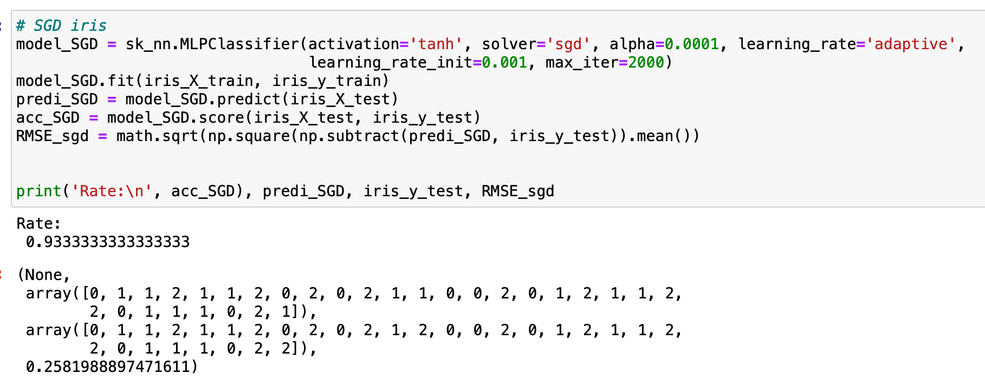
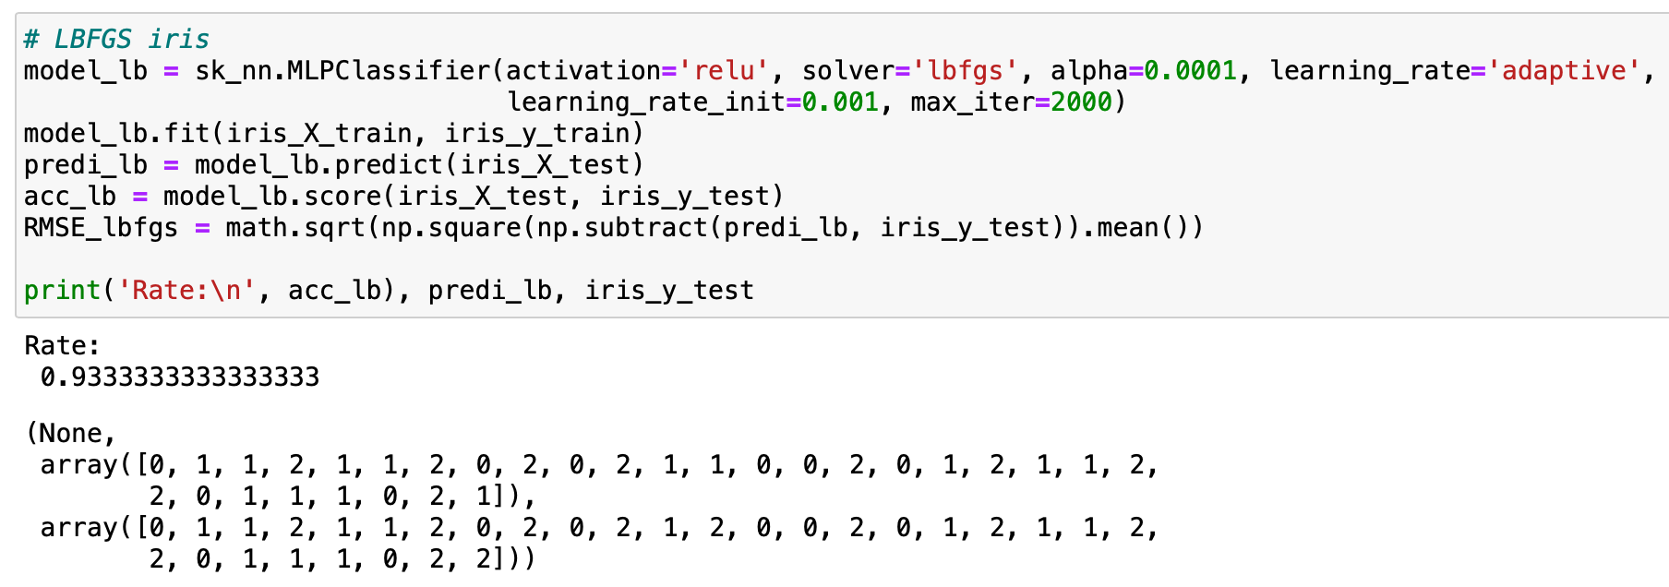
Example 1: Iris Classification
Stochastic Gradient Descent
Limited-memory Broyden–Fletcher–Goldfarb–Shanno

Slide 31
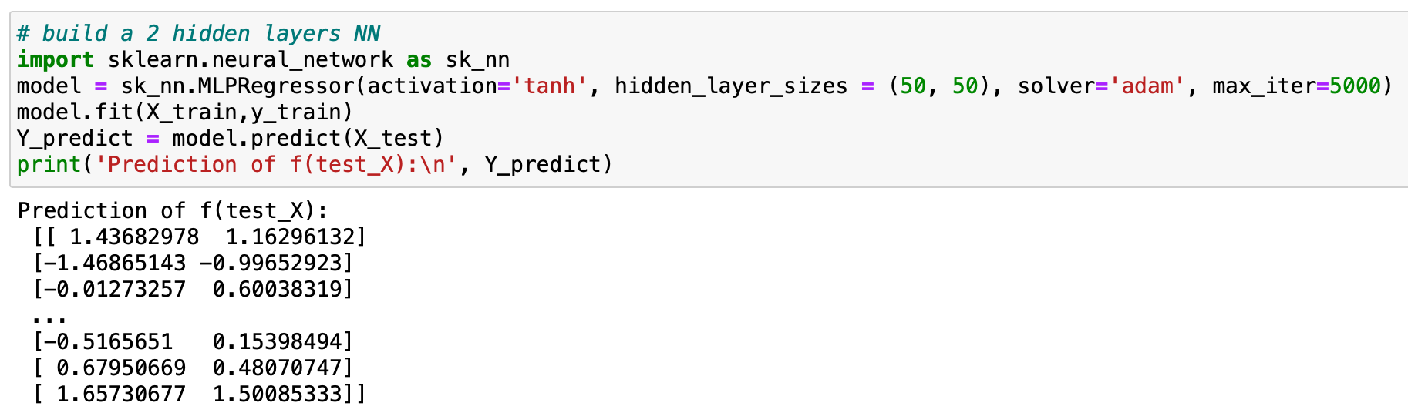
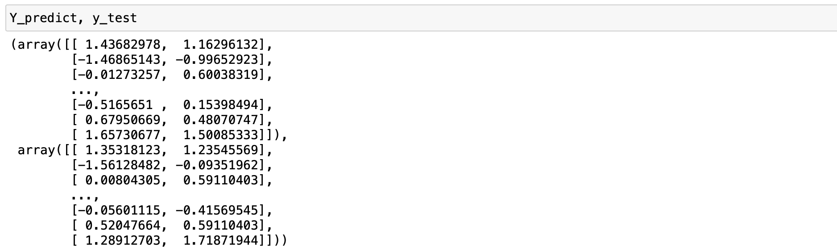
Example 2: LDAPS Regression

Slide 32
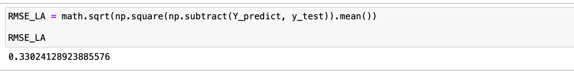
Example 2: LDAPS Regression

Slide 33
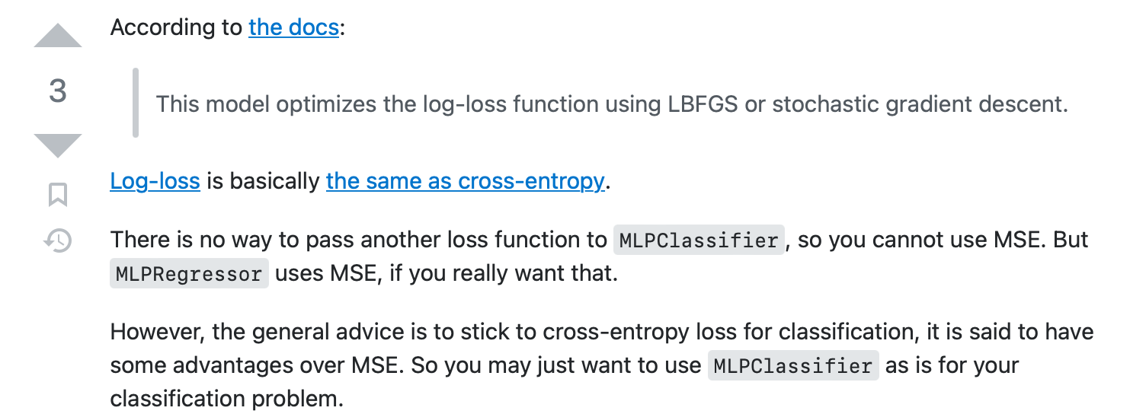
Remark
MLPClassifier use Cross entropy(log-loss) as loss function
MLPRegressor use MSE as loss function
More details refer to the sklearn tutorial website

Slide 34
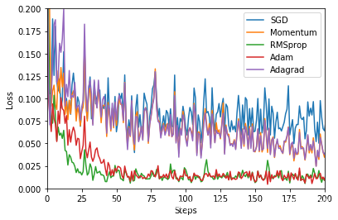

Optimizer
Common Optimizers:
SGD
Nesterov Momentum
ASGD
Rprop
Adagrad
Adadelta
RMSprop
Adam(AMSGrad)
Adamax
SparseAdam
LBFGS

Slide 35

Optimizer
Common Optimizers:
SGD
Nesterov Momentum
ASGD
Rprop
Adagrad
Adadelta
RMSprop
Adam(AMSGrad)
Adamax
SparseAdam
LBFGS

Slide 36
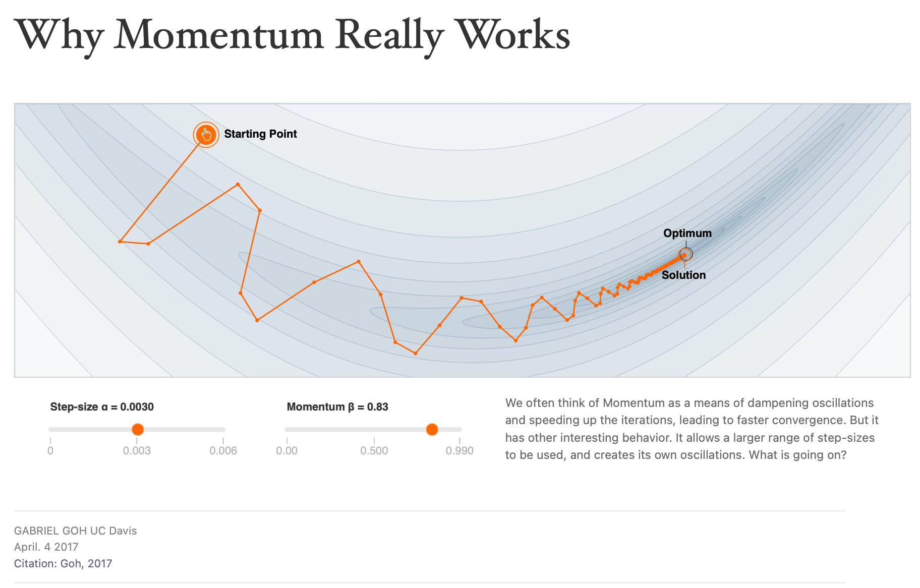
Optimizer
https://distill.pub/2017/momentum/

Slide 37
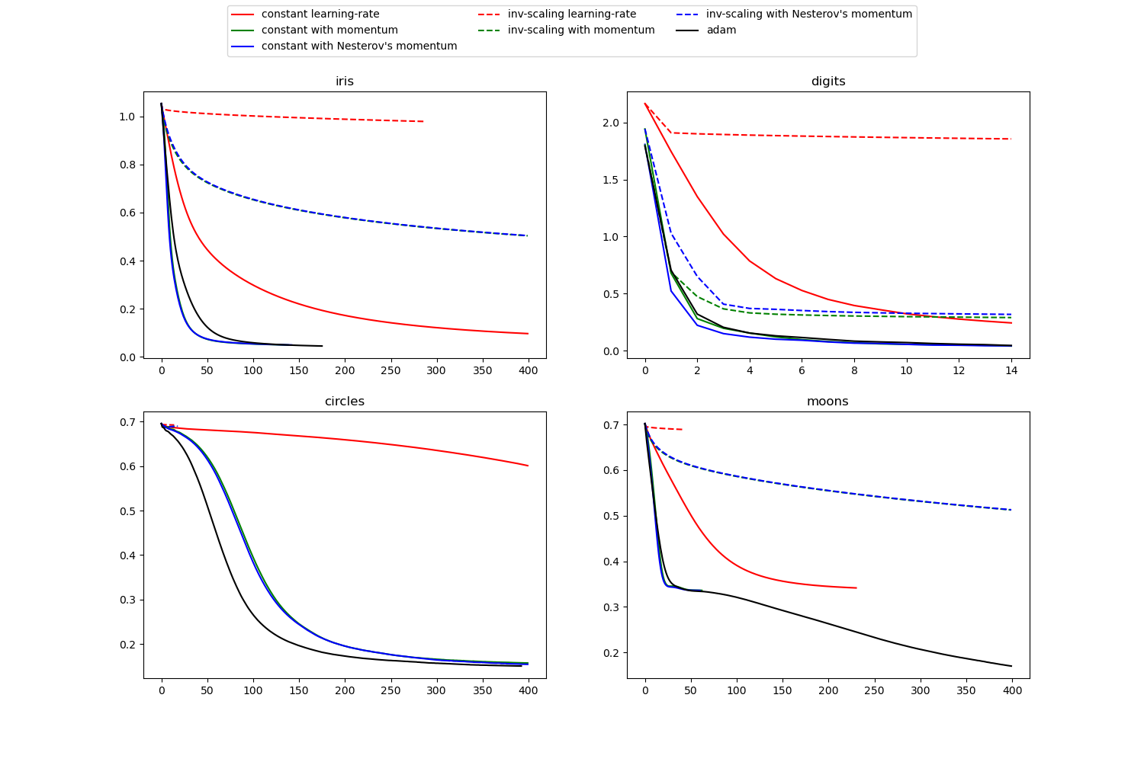
Optimizer Parameter Selection
Take care your learning rate!

Slide 38



Optimizer

Slide 39

Optimizer Parameter Selection
If you don’t know how to select learning rate, maybe you can follow this Karpathy Constant

Slide 40

Regularization Parameter Selection
Train SVM model with different regularization parameters \alpha from 0.10 to 10.00

Slide 41

Activation Functions Selection

Slide 42


Activation Functions Selection
sigmoid vs. tanh
Figure from Glorot & Bentio (2010)

Slide 43


Extension: MNIST Classification by Pytorch
Pytorch Deep NN for MNIST
PyTorch Deep Explainer MNIST example: https://www.kaggle.com/code/ceshine/pytorch- deep-explainer-mnist-example/notebook
Dive into Deep Learning_Li Mu, Fashion-MNIST datasets
http://zh.d2l.ai/chapter_linear-networks/image-classification-dataset.html
Xiao, H., Rasul, K., & Vollgraf, R. (2017). Fashion-mnist: a novel image dataset for benchmarking machine learning algorithms. arXiv preprint arXiv:1708.07747.

Slide 44
Thanks!
Dan Qiao
danqiao@link.cuhk.edu.cn
OH: 16:00~17:00, Friday, Seat 81, SDS Lab in ZX Building
Nov. 8, 2022

